Slide 1
Clock
SPI
10k Select
50k Select
100k Select
10k Pots
50k Pots
100k Pots
X Select
Y Select
X DAC
Y DAC

Slide 2
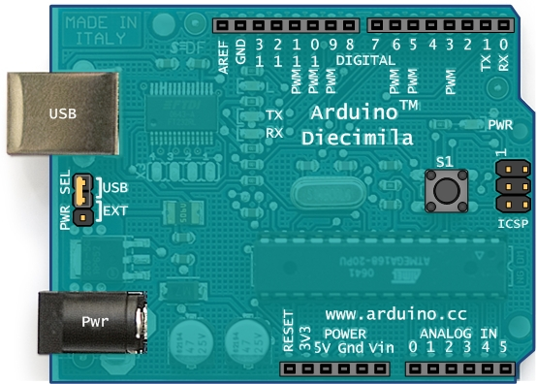
Y DAC select
Indicator LED
100k select
X DAC select
50k select
SPI to slave chips
10k select
Clock
X in
Y in
Z in

